Slide 1

PROCESS MINING VIRTUAL INTERNSHIP
by
P. HARSHITHA
Roll No. 214G1A3223
Department of Computer Science and Engineering (Data Science)
Srinivasa Ramanujan Institute of Technology
(Affiliated to JNTUA & Approved by AICTE) (Accredited by NAAC with ‘A’ Grade & Accredited by NBA (EEE, ECE & CSE)
Rotarypuram Village, B K Samudram Mandal, Ananthapuramu – 515701.
2023 - 2024

Slide 2

Contents
Course Objective
Introduction
Technology
Applications
Modules
Real time applications
outcomes
GitHub Link
Queries

Slide 3
Course Objective
Understanding the fundamental concepts and principles of process mining.
Gaining knowledge in using process mining tools and software.
Understand different algorithms and methods used for process discovery and their respective strengths and limitations.
Understanding Process Mining Concepts: Gain a solid grasp of the fundamental concepts of process mining, including process discovery, conformance checking, and enhancement. Understand how process mining fits into the broader context of business process management.

Slide 4
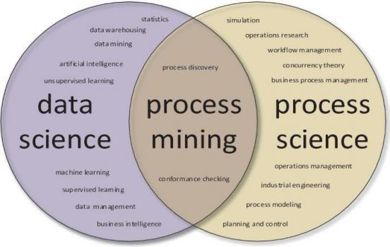
INTRODUCTION
Process Mining is often described as occupying the area between business process management and data mining. The speed, accuracy, and these technologies deliver can result in significant cost savings and much faster time to market.

Slide 5
Introduction
It is a technique in the field of process management that supports the analysis of business processes based on event logs and drives improved efficiency, effectiveness and compliance through its insights.
The real-world examples of process mining are:
1. Sales order
2. Telecommunications
3. Manufacturing
4. Automotive
5. Customer service desk

Slide 6
Technology
By using process mining technology, companies can also enhance the quality of their internal processes. This may encourage staff members to think more creatively when developing new project ideas and receive more high-quality data from each step in the process.
Techniques:
Process Discovery: Uncover hidden process models from event data
Conformance: Identify deviations and compliance issues.
Process Enhancement: Optimize processes through insights and analysis.

Slide 7
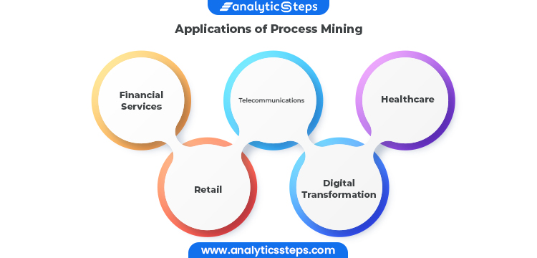
Applications

Slide 8
Applications
Process Mining can be applied in different sectors, mentioned few application areas where process mining is implemented
1. Manufacturing
2. Services
3. Health Care
4. Audit & Banking
5. Telecommunications
6. Consumer Goods
7. Educational/Research

Slide 9
Modules
Process mining modules are software components that enable you to analyze and improve your business processes based on data from your underlying systems.
Modules:
1. Data Intake The first step in process mining is obtaining data.
2. Process Discovery Once the system collects your data, it begins to analyze it.
3. Process Analytics Next, you can study any gaps or inefficiencies that the data intake might have identified.
4. Process Comparison Many organizations also engage in process comparison during data mining.
5. Conformance Checking

Slide 10
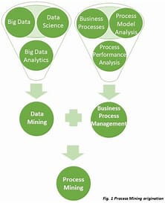
Modules

Slide 11
Modules
Why is process mining important?
Data Quality: Finding, merging and cleaning data is usually required to enable process mining. Data might be distributed over various data sources. It can also be incomplete or contain different labels or levels of granularity. Accounting for these differences will be important to the information that a process model yields.
Concept drift: Sometimes processes change as they are being analyzed, resulting in concept drift.

Slide 12
Real Time Applications
1. Supply Chain Optimization: Process mining can be used to analyze and optimize supply chain processes in real-time. It helps identify bottlenecks, inefficiencies, and deviations from the ideal process flow, enabling organizations to make informed decisions and adjustments on the fly.
2. Healthcare Process Improvement: In healthcare, process mining can be applied to analyze patient treatment pathways, identify variations, and optimize resource allocation in real-time. This can lead to improved patient care and reduced wait times.
3. Manufacturing Process Analysis: Process mining can monitor and analyze manufacturing processes in real-time to ensure that production is running smoothly, detect anomalies or deviations from the standard process, and make immediate adjustments to prevent defects or disruptions.

Slide 13
Real Time Applications
4. Financial Transaction Monitoring: Process mining can be used in the financial sector to monitor and detect fraudulent activities in real-time. By analyzing transaction logs, it can identify patterns of suspicious behavior and trigger alerts for further investigation.
5. IT Service Management: Process mining can help IT departments optimize their service management processes by monitoring the flow of IT service requests, identifying bottlenecks, and streamlining incident resolution and request fulfillment.
6. Logistics and Transportation: Real-time process mining can be applied to logistics and transportation operations to monitor the movement of goods, track delivery routes, and optimize the overall supply chain to ensure timely and efficient deliveries.

Slide 14
Real Time Applications
7.Customer Journey Analysis: Process mining can provide insights into customer interactions and behaviors across various touchpoints in real-time.This information can be used to improve customer experiences and optimize marketing and sales strategies.
8.Energy Management: Process mining can monitor energy consumption patterns in real-time to identify energy wastage, optimize energy usage, and reduce operational costs for industrial facilities and buildings.
9.Emergency Response and Disaster Management: During emergency situations, process mining can help emergency responders analyze data in real-time to allocate resources effectively, optimize response times, and make informed decisions to manage crises.

Slide 15
OUTCOMES
After completing this Training Track, you will be able to:
•Interpret process visualizations and leverage analyses to identify process inefficiencies.
•Conceptualize your process in terms of activities and cases.
•Save an analysis selection for future reference and share it with your team, export visualizations and process data.
•Perform the basic tasks necessary to build Celonis analyses.
•Become familiar with Analysis Settings and Permissions.
•Put your knowledge about the theoretical foundations of Process Mining into practice.

Slide 16
Conclusion
This course explains the key analysis techniques in process mining will learn various process discovery algorithms. These can automatically learn process models from raw event data various analysis techniques that use event data will be presented.

Slide 17
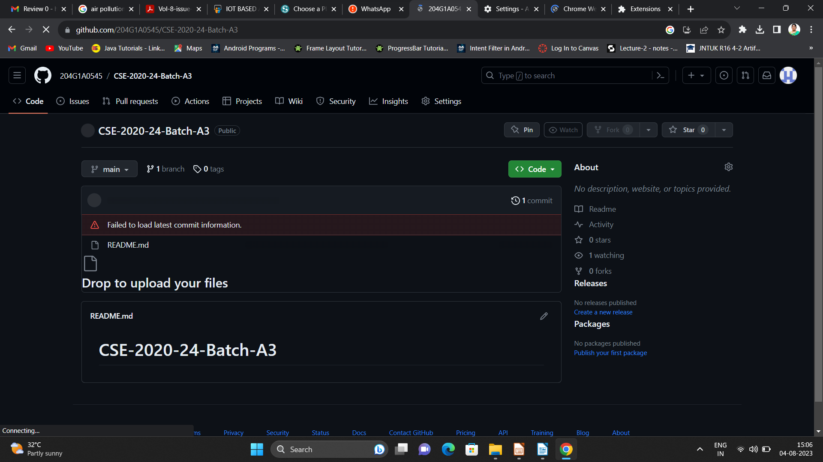

Git Hub Dashboard
Repository Name Like: Summer Internship - I
Under that include document, presentation and Certificate(Pdf).

Slide 18
Any Queries?

Slide 19
Thank You!!!

